Slide 1
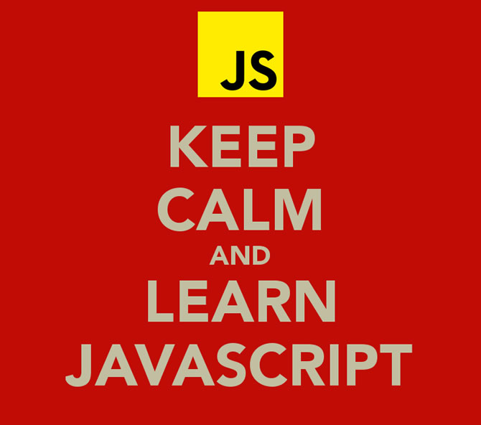
Javascript

Slide 2
What is Javascript?
Developed by Netscape in 1995 to create applications that runs in a browser and replace plugins (like Java applets)
It's not related with Java, it was named JavaScript for marketing reasons (Java was very popular at that moment)
Only needs a browser to run (client side)

Slide 3
Including Javascript
JavaScript will be place between <script> and </script> tags
<!DOCTYPE html>
<html>
<head>
<script>
// my javascript code
</script>
</head>
</html>
<script> tags can be place anywhere in the <head> or <body> sections
In an external javascript file (.js extension)
<!DOCTYPE html>
<html>
<body>
<script src="myScript.js"></script>
</body>
</html>
Placing JavaScripts in external files:
  It makes HTML and JavaScript easier to read and maintain
  Cached JavaScript files can speed up page loads

Slide 4
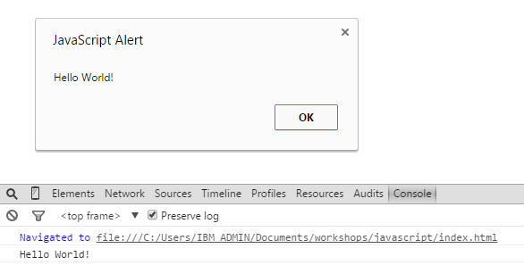
Hello world example
<!DOCTYPE html>
<html>
<body>
<script src="js/helloworld.js">
</script>
</body>
</html>
alert(„Hello World”!);
console.log(„Hello World”!);

Slide 5
Javascript Primitive Data Types
Null and undefined
In Javascript there is only one type of numbers: Number. So 3 is a Number, 3.5 is a Number
Strings are text inside quotes. You can use sigle or double quotes: „This is a string!” or 'This is another string.' or „This text contains a \”quoted\” text”
Boolean represents one of the two values: true or false. In Javascript anything with a REAL value is true. For example these are false: 0, „” (empty string), null, undefined, false, NaN.

Slide 6
Javascript Variables
You can declare a variable using var keyword
var myVariable;
var mySecondVariable, myThirdVariable;
Not using var Javascript will still create the variable (global).
You can create an declare a variable in the same time:
var myVariable = 7;
Javascript is case-sensitive, so myVariable and myvariable will be different. So please be carefully, in this case you'll have 2 variables:
var myVariable;
myvariable = 7;

Slide 7
Javascript Operators
var x = 9;
var y = 5;
console.log(x+y);
console.log(x-y);
console.log(x*y);
console.log(x/y);
console.log(x%y);
x++;
y--;
console.log(x+”:”+y);
+ Addition
- Subtraction
* Multiplication
/ Division
% Modulus
++ Increment
-- Decrement

Slide 8
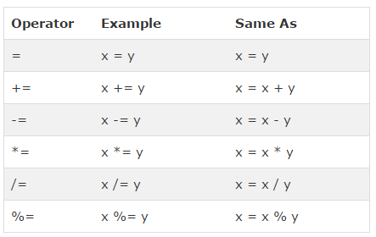
Javascript Assignment Operators
var y = 10;
var x = y;
console.log("x=y: "+x);
x = 5;
x+= y;
console.log("x+=y: "+x);
x = 25;
x-= y;
console.log("x-=y: "+x);
x = 3;
x*=y;
console.log("x*=y: "+x);
x = 50;
x/=y;
console.log("x/=y: "+x);
x = 15;
x%=y;
console.log("x%=y: "+x);

Slide 9
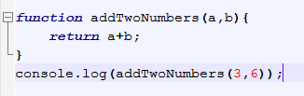
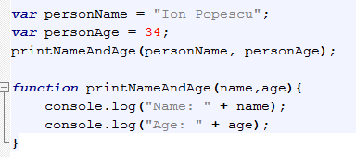
Javascript Functions
function name(parameter1, parameter2, parameter3) {
code to be executed
}

Slide 10
Javascript Scope
Variables declared inside a function are local and can be accessed only inside that function
function myFridge(){
  var myMilk = 3;
  console.log(myMilk); // no error
}
MyFridge();
console.log(myMilk); // error
All other variables are global
A variable declared in a function without the keyword var is global:
function myFridge(){
  myMilk = 3;
  console.log(myMilk); // no error
}
myFridge();
console.log(myMilk); // no error

Slide 11
Javascript Arrays
An array is a special variable that can hold more than a value at a time. Instead of:
  var fruit1 = "apple";
  var fruit2 = "pear";
  var fruit3 = "peach";
You can declare an array:
  var fruits = ["apple", "pear", "peach"];
  console.log(fruits);
  console.log(fruits[0]);
  console.log(fruits[1]);
  console.log(fruits[2]);

Slide 12
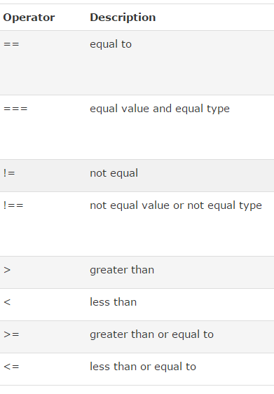
Javascript Comparison Operators
var x = 10;
console.log(x==10);
console.log(x==5);
console.log(x=="10");
console.log(x==="10");
console.log(x!=10);
console.log(x!==10);
console.log(x!=="10");
console.log(x>10);
console.log(x>=10);
console.log(x<10);
console.log(x<=10);

Slide 13
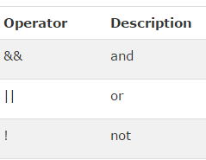
Javascript Logical Operators
console.log((x<15)&&(y>0));
console.log((x<15)&&(y>5));
console.log((x<15)||(y>0));
console.log((x<15)||(y>5));
console.log((x<5)||(y>5));
console.log(x==y);
console.log(!(x == y));

Slide 14
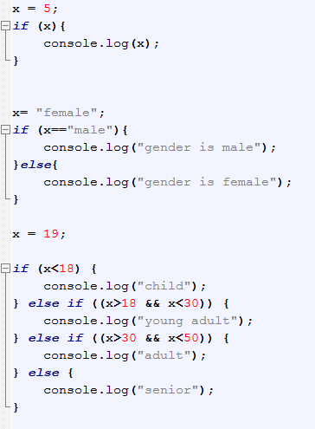
Javascript If...Else Statements
if (condition) {
code to be executed if the condition is true
}
if (condition) {
code to be executed if the condition is true
} else {
code to be executed if the condition is false
}
if (condition1) {
code to be executed if condition1 is true
} else if (condition2) {
code to be executed if the condition1 is false and condition2 is true
} else {
code to be executed if the condition1 is false and condition2 is false
}

Slide 15
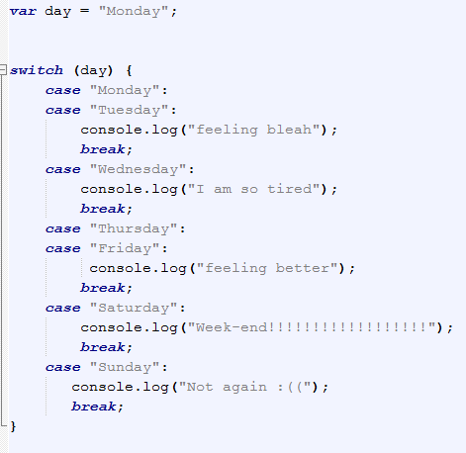
Javascript Switch Statement
switch(expression) {
case n:
code block
break;
case n:
code block
break;
default:
default code block
}

Slide 16
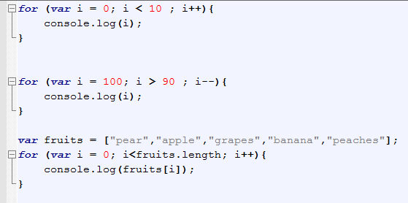
Javascript For
for (statement 1; statement 2; statement 3) {
code block to be executed
}
Statement 1 is executed before the loop (the code block) starts.
Statement 2 defines the condition for running the loop (the code block).
Statement 3 is executed each time after the loop (the code block) has been executed.

Slide 17
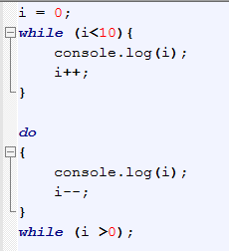
Javascript While
while (condition) {
code block to be executed
}
do {
code block to be executed
}
while (condition);

Slide 18
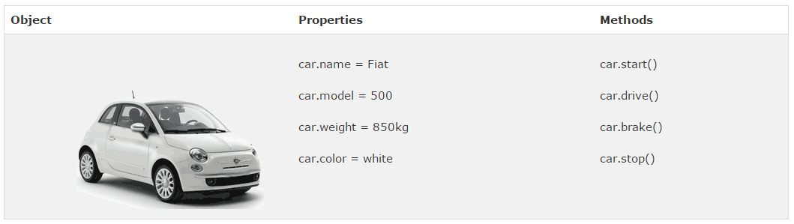
Javascript Objects
All cars have the same properties, but the property values differ from car to car.
All cars have the same methods, but the methods are performed at different times.

Slide 19
Javascript Objects
var car = {name:"Fiat", model:500, weight:"850kg", color:"white"};
console.log(car.type);
console.log(car.model);
console.log(car.color);

Slide 20
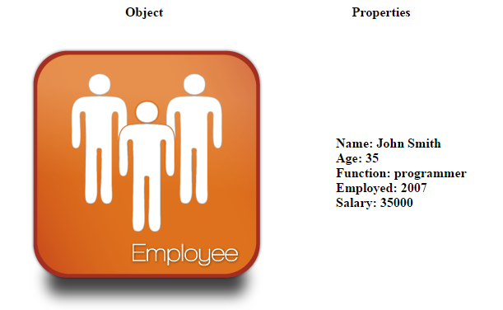
Javascript Objects – Exercise 1

Slide 21
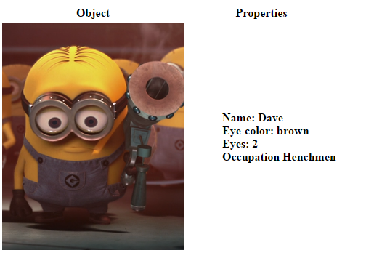
Javascript Objects – Exercise 2

Slide 22
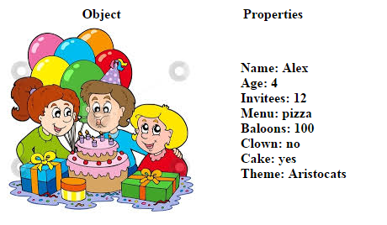
Javascript Objects – Exercise 3

Slide 23
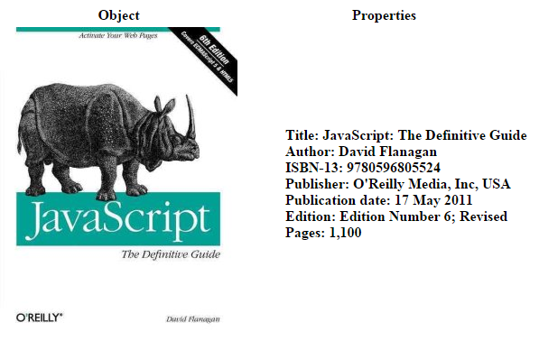
Javascript Objects – Exercise 4

